Slide 1
Lecture 13 RDD Programming
ITP4869 Analysis with Programming Tools
(AY 2018/19)
Dr. Johnny Cheng

Slide 2
Lessons Intended Learning Outcomes
On completion of this lesson, students are expected to be able to:
Explain the rationale behind Resilient Distributed Datasets (RDDs);
Create RDDs from internal collections and external storage;
Write PySpark code using RDD operations;

Slide 3

Overview of RDD

Slide 4
Overview of RDD
Resilient Distributed Dataset (RDD) is Spark’s core abstraction for working with data.
An RDD is simply an immutable distributed collection of elements.
In Spark all work is expressed as either creating new RDDs, transforming existing RDDs, or calling operations on RDDs to compute a result.
Each RDD is split into multiple partitions, which may be computed on different nodes of the cluster.

Slide 5
Overview of RDD (cont.)
RDDs can contain any type of Python, Java, or Scala objects, including user-defined classes.
Users create RDDs in two ways:
By loading an external dataset; or
By distributing a collection of objects in their driver program (parallelized collections).
Once created, RDDs offer two types of operations:
Transformations
Actions

Slide 6
Overview of RDD (cont.)
Transformations construct a new RDD from a previous one.
For example, one common transformation is filtering data that matches a condition.
Actions, on the other hand, compute a result based on an RDD, and either return it to the driver program or save it to an external storage system.
One example of an action is first(), which returns the first element in an RDD.

Slide 7
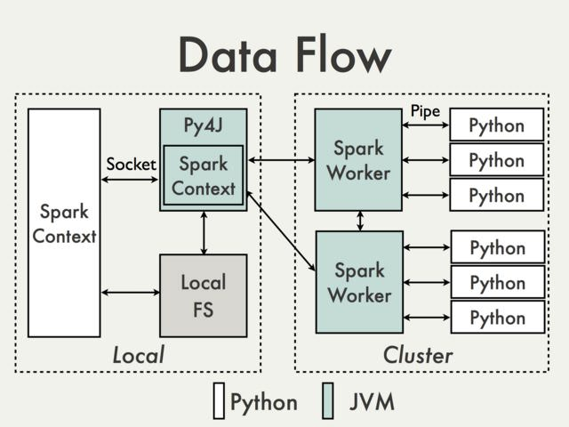
Overview of RDD (cont.)
PySpark is built on top of Spark’s Java API.
Data is processed in Python and cached/shuffled in the JVM.

Slide 8
Parallelized Collections
Parallelized collections are created by calling SparkContext’s parallelize method on an existing iterable or collection in your driver program.
The elements of the collection are copied to form a distributed dataset that can be operated on in parallel.
For example, here is how to create a parallelized collection holding the numbers 1 to 5:
data = [1, 2, 3, 4, 5]
distData = sc.parallelize(data)

Slide 9
Parallelized Collections (cont.)
Once created, the distributed dataset (distData) can be operated on in parallel.
For example, we can call
distData.reduce(lambda a, b: a + b)
to add up the elements of the list.
One important parameter for parallel collections is the number of partitions to cut the dataset into
Spark will run one task for each partition of the cluster.
Typically you want 2-4 partitions for each CPU in your cluster.

Slide 10
Parallelized Collections (cont.)
Normally, Spark tries to set the number of partitions automatically based on your cluster.
However, you can also set it manually by passing it as a second parameter to parallelize.
For example,
sc.parallelize(data, 10)
Note: some places in the code use the term slices (a synonym for partitions) to maintain backward compatibility.

Slide 11

Creating RDDs

Slide 12
Creating RDDs
Spark provides two ways to create RDDs: loading an external dataset and parallelizing a collection in your driver program.
We can create an RDD by parallelizing an existing collection:
lines = sc.parallelize(['spark', 'rdd', 'python'])
We can also create an RDD by loading data from external storage:
data = sc.textFile('data.txt')
data.flatMap(lambda line: line.split(' '))
.collect()

Slide 13
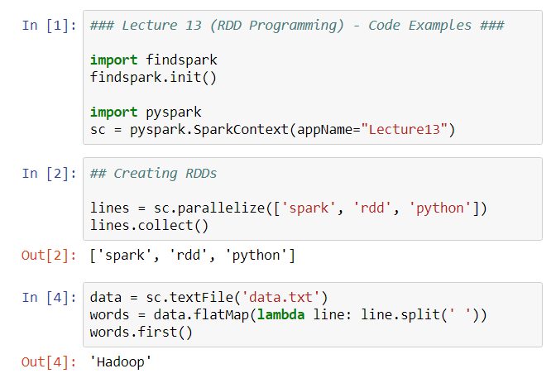
Creating RDDs (cont.)

Slide 14
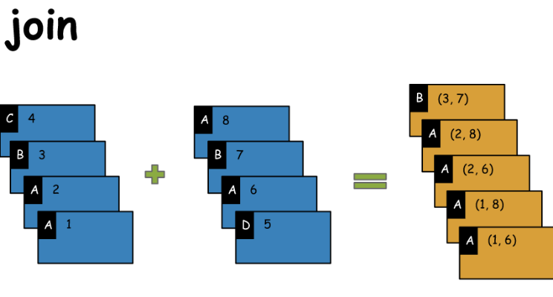
RDD Operations
Basic RDDs
Transformations
Actions

Slide 15
Basic RDDs
RDDs support two types of operations: transformations and actions.
All transformations in Spark are lazy, in that they do not compute their results right away.
Instead, they just remember the transformations applied to some base dataset (e.g. a file).
The transformations are only computed when an action requires a result to be returned to the driver program.
This design enables Spark to run more efficiently.

Slide 16
Basic RDDs (cont.)
To illustrate RDD basics, consider the simple program below:
lines = sc.textFile("data.txt")
lineLengths = lines.map(lambda s: len(s))
totalLength = lineLengths.reduce(lambda a, b: a + b)
print(lines.collect())
print(lineLengths.collect())
print('Total length is', totalLength)
This code fragment loads text lines from a text file; computes the length of each line; and sums up the total length of the whole file.

Slide 17
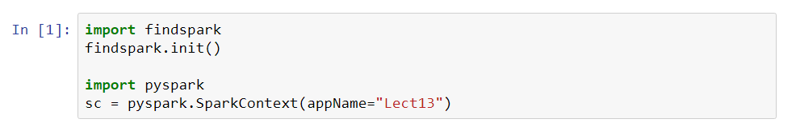
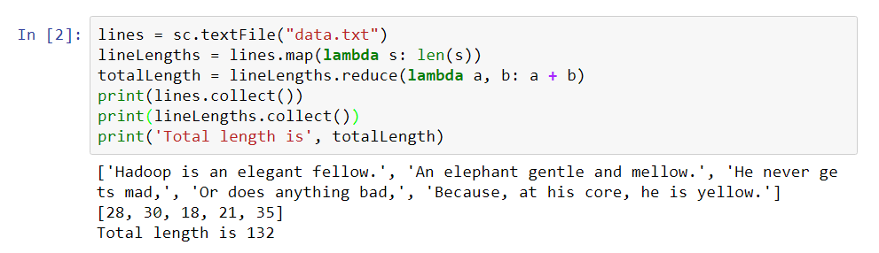
Basic RDDs (cont.)

Slide 18
Transformations
Spark Transformation is a function that produces new RDD from the existing RDDs.
Applying transformation built an RDD lineage, with the entire parent RDDs of the final RDD(s).
RDD lineage, also known as RDD operator graph or RDD dependency graph.
It is a logical execution plan, i.e., it is Directed Acyclic Graph (DAG) of the entire parent RDDs of RDD.

Slide 19
Transformations (cont.)
Transformations are lazy in nature, i.e., they get execute when we call an action.
They are not executed immediately. Two most basic type of transformations is a map(), filter().
After the transformation, the resultant RDD is always different from its parent RDD.
It can be smaller (e.g. filter, count, distinct, sample), bigger (e.g. flatMap(), union(), Cartesian()) or the same size (e.g. map).

Slide 20
Transformations (cont.)
There are various functions in RDD transformation.
Let us see RDD transformation with examples.
map(func) – The map function iterates over every line in RDD and split into new RDD.
Using map() transformation we take in any function, and that function is applied to every element of RDD.
For example,
rdd = sc.parallelize(range(1,6))
result = rdd.map(lambda x: x+2)
result.collect()

Slide 21
Transformations (cont.)
flatMap(func) – With the help of flatMap() function, to each input element, we have many elements in an output RDD.
The most simple use of flatMap() is to split each input string into words.
Map and flatMap are similar in the way that they take a line from input RDD and apply a function on that line.
The key difference between map() and flatMap() is map() returns only one element, while flatMap() can return a list of elements.

Slide 22
Transformations (cont.)
Compare the results of the two code fragments:
rdd = sc.textFile("data.txt")
lines = rdd.flatMap(lambda lines: lines.split(' '))
lines.collect()
rdd = sc.textFile("data.txt")
lines = rdd.map(lambda lines: lines.split(' '))
lines.collect()

Slide 23
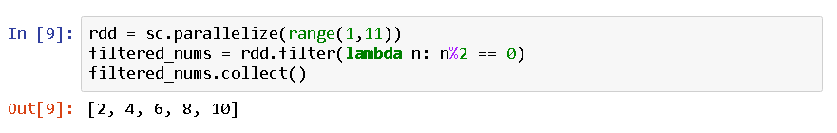
Transformations (cont.)
filter(func) – Spark RDD filter() function returns a new RDD, containing only the elements that meet a predicate (condition).
For example,

Slide 24
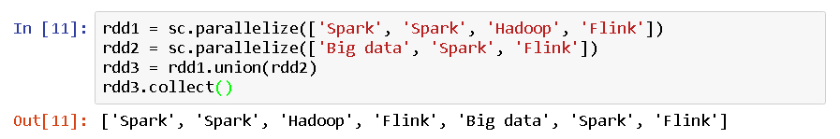
Transformations (cont.)
union(dataset) – With the union() function, we get the elements of both the RDD in new RDD.
The key rule of this function is that the two RDDs should be of the same type.
For example,

Slide 25
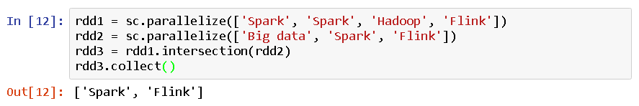
Transformations (cont.)
intersection(dataset) – With the intersection() function, we get only the common element of both the RDD in new RDD.
The key rule of this function is that the two RDDs should be of the same type.
For example,

Slide 26
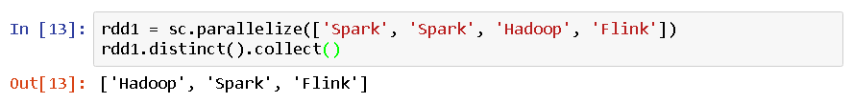
Transformations (cont.)
distinct() – It returns a new dataset that contains the distinct elements of the source dataset.
It is helpful to remove duplicate data.
For example,

Slide 27
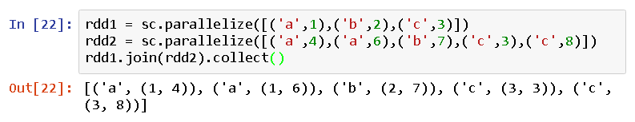
Transformations (cont.)
join() – The Join is database term. It combines the fields from two table using common values.
This operation in Spark is defined on pair-wise RDD.
Pair-wise RDDs are RDDs in which each element is in the form of tuples.
Where the first element is key and the second element is the value.
For example,

Slide 28
Actions
Actions are Spark RDD operations that give non-RDD values.
The values of action are stored to drivers or to the external storage system.
It brings laziness of RDD into motion.
An action is one of the ways of sending data from Executer to the driver.
Executors are agents that are responsible for executing a task.
While the driver is a JVM process that coordinates workers and execution of the task.

Slide 29
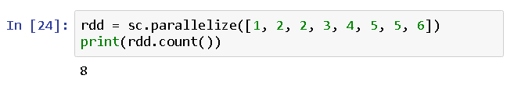
Actions (cont.)
count() – Action count() returns the number of elements in RDD.
For example,

Slide 30
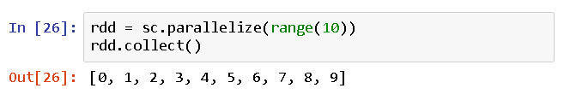
Actions (cont.)
collect() – The action collect() is the common and simplest operation that returns (as a list) our entire RDDs content to driver program.
The application of collect() is unit testing where the entire RDD is expected to fit in memory.
As a result, it makes easy to compare the result of RDD with the expected result.
For example,

Slide 31
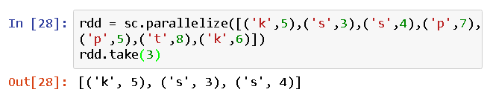
Actions (cont.)
take(n) – The action take(n) returns n number of elements from RDD.
It tries to cut the number of partition it accesses, so it represents a biased collection.
We cannot presume the order of the elements.
For example,

Slide 32
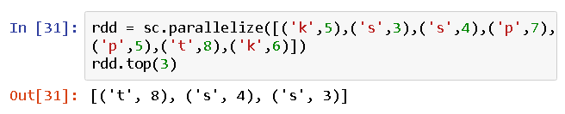
Actions (cont.)
top(n) – If ordering is present in our RDD, then we can extract top elements from our RDD using top().
Action top() uses default ordering of data.
For example,

Slide 33
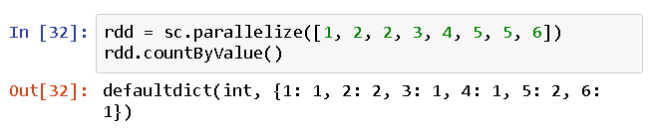
Actions (cont.)
countByValue() – The countByValue() returns, many times each element occur in RDD.
For example,

Slide 34
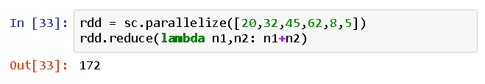
Actions (cont.)
reduce() – The reduce() function takes the two elements as input from the RDD and then produces the output of the same type as that of the input elements.
The simple forms of such function are an addition.
We can add the elements of RDD, count the number of words.
It accepts commutative and associative operations as an argument.
For example,

Slide 35
Actions (cont.)
fold() – The signature of the fold() is like reduce().
Besides, it takes “zero value” as input, which is used for the initial call on each partition.
But, the condition with zero value is that it should be the identity element of that operation.
The key difference between fold() and reduce() is that, reduce() throws an exception for empty collection, but fold() is defined for empty collection.
For example, zero is an identity for addition; one is identity element for multiplication.
The return type of fold() is same as that of the element of RDD we are operating on.

Slide 36
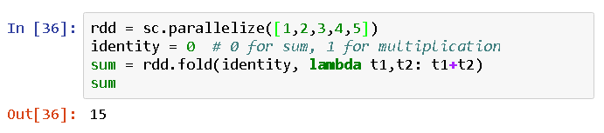
Actions (cont.)
Consider the example of fold(),

Slide 37
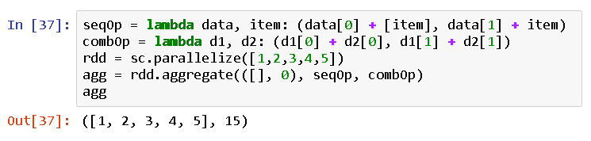
Actions (cont.)
aggregate() – The aggregate() takes two functions to get the final result.
Through one function we combine the element from our RDD with the accumulator, and the second, to combine the accumulator.
Hence, in aggregate, we supply the initial zero value of the type which we want to return.
For example,

Slide 38
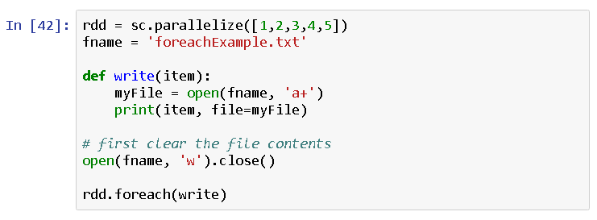
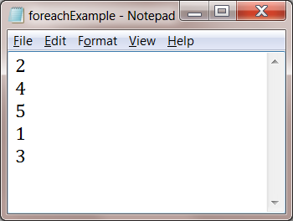
Actions (cont.)
foreach() – When we have a situation where we want to apply operation on each element of RDD, but it should not return value to the driver.
In this case, foreach() function is useful.
For example, writing data into a file.

Slide 39

Self Study Guide

Slide 40
Self Study Guide
Reference
Holden Karau, et al. (2015). Learning Spark, O’Reilly.
(Read Ch. 3)
RDD Programming Guide
https://spark.apache.org/docs/latest/rdd-programming-guide.html
PySpark API
http://spark.apache.org/docs/2.4.3/api/python/pyspark.html

